Slide 1
What is the TEI and Why Should I Care?
Joey Takeda
September 20th, 2018
UBC DH Pixelating Mixer

Slide 2
Hi!
Joey Takeda, MA Student, Dept. of English Language and Literatures (Science and Technology Studies Program)
Undergrad in English Honours and Gender Studies @ Uvic
Digital Humanities programmer for projects such as The Map of Early Modern London, The Internet Shakespeare Editions, Linked Early Modern Drama Online, and The Endings Project
Specialize in TEI, XHTML, and Digital Humanities project development
https://github.com/joeytakeda
This workshop: https://github.com/joeytakeda/teiworkshop

Slide 3
This Workshop
Brief conceptual introduction to encoding, XML, and TEI
Examples of projects that use the TEI
Pointers to further resources on learning about the TEI
Next workshop will focus on tools and resources for creating a TEI project (October 25)

Slide 4
Text Encoding and the TEI

Slide 5
Encoding, markup, et cetera…
At its core, textual encoding is a way of identifying and differentiating bits of text from other bits of texts.
We do this all the time!
Italics for emphasis
Underlining for titles
Bold for extra-emphasis
Quotation marks for “outside attribution” or “skepticism”
All capitals to YELL

Slide 6
Encoding, markup, et cetera
But these are contextual and local
E.g. different types of punctuation for levels of quotation
And they are subject to varying interpretations
E.g. I think these quotation marks denote a term, but maybe the author is just being sarcastic…

Slide 7
The TEI
A non-profit organization
A set of guidelines for encoding text
A community or consortium of users
Website: https://tei-c.org/

Slide 8
The TEI
Is a markup language written in XML
Currently in its 5th major revision (P5 3.3.1)
Offers a rich vocabulary and method to encode
Bibliographic and structural features: page breaks, headers, footers, page numbers, line breaks, divisions, paragraphs, line groups, etc
Interpretative features: stage movement, emphasis, place names, proper names, dialogue direction
Editorial apparatus: hands, witnesses, collation, gaps, additions, deletions
+++++

Slide 9
Quick History of the TEI
The Text Encoding Initiative (originally called the Guidelines for Text Encoding and Interchange)
Started in the late 1980s as a response to the boom in “humanities computing”
Wanted to provide a framework and a set of principles for encoding texts that could be widely adopted

Slide 10
Within the noisy market place of the Digital Humanities, the TEI is a kind of senior member, an annoying parental figure for some, a benevolent one for others, something just too old-fashioned even to be considered for others. Yet, over the last decade, it has become increasingly clear that the TEI is part of what makes the digital humanities happen.
(Burnard, “Conclusion”, para. 1)

Slide 11
What the TEI is not
The TEI is not a language that describes how a text should be displayed online or in print. It should always concern the performative and expressive significance of the input, not the aesthetics of the output.
The TEI is not a programming language; that is, encoding your texts in TEI does not automatically do anything to them
Caveat: There are many, many tools for transforming TEI into other formats (Word documents, PDFs, and, of course, websites)

Slide 12
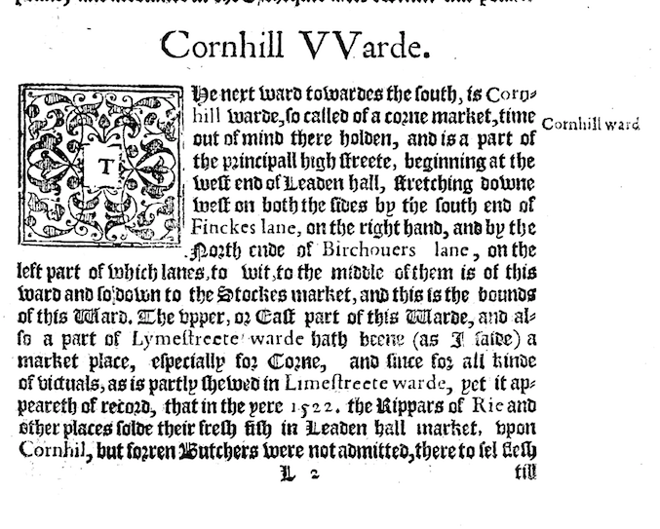
Stow’s Survey of London

Slide 13
Stow’s Survey of London

Slide 14
Stow’s Survey of London

Slide 15
Stow’s Survey of London

Slide 16
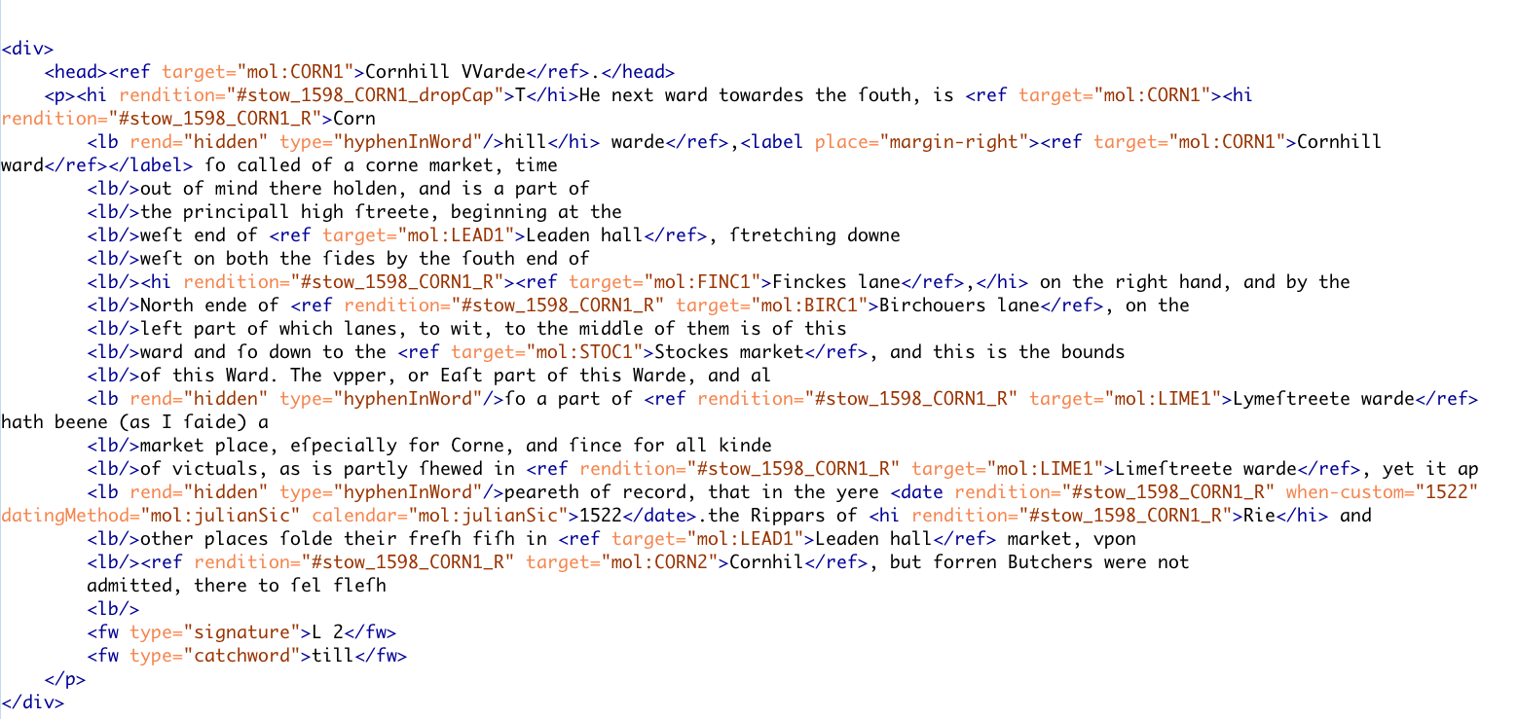

Slide 21
XML
The TEI is written in XML (eXtensible Markup Language)
XML is not a set language unto itself, but a grammar
XML is hierarchical
XML is a tree-like structure
And is often described in genealogical terms

Slide 22
XML
Think of the hierarchy of the book:
Book
Chapters
Sections
Paragraphs
Sentences
Words
Letters

Slide 23
XML
<book> <chapter> <section type=“subsection”> <paragraph> <sentence> <word> <letter></letter> </word> </sentence> </paragraph> </section> </chapter> </book>

Slide 24
XML Explained
The two pointy brackets is called an element
E.g. <book> would be called the book element
All elements have start and end tags
E.g. <book> is the start tag and </book> is the end tag
Elements cannot overlap
<sentence><word>Word1</word></sentence> is right
<sentence><word>Word1</sentence></word> is wrong
Elements can also have attributes and each attribute must have a value
E.g. <book type= “primary”> has a type attribute with the value of primary
(Think of attributes as you would in everyday life; people don’t have “height” or “age” without a value)

Slide 25
XML Explained
Elements nest and use genealogical terms
I.e this bit of XML
<book>
<chapter></chapter>
</book>
Can be described as “chapter is a child of book” OR “book is a parent of chapter”

Slide 26
The Problem
I just wrote that XML to describe a book
How else could it be written?
<book> <ch> <para> <w> <c></c> </w> </para> </ch> </book>

Slide 27
The TEI Solution
All texts must be called <text>
All divisions (whether they be chapters, sections, et cetera) must be called <div>
All paragraphs must be called <p>
All words must be called <w>
+++

Slide 28
Components of a (basic) TEI file
Root <TEI> element
A <teiHeader> that describes both the file and the primary source that you are transcribing (if applicable)
A <text> that contains the text of the document
Within text, you can have a <front>, <body>, or <back>

Slide 29
TEI is for Data and Metadata
<TEI>
<teiHeader>
</teiHeader>
<text>
</text>
</TEI>
metadata
data

Slide 30
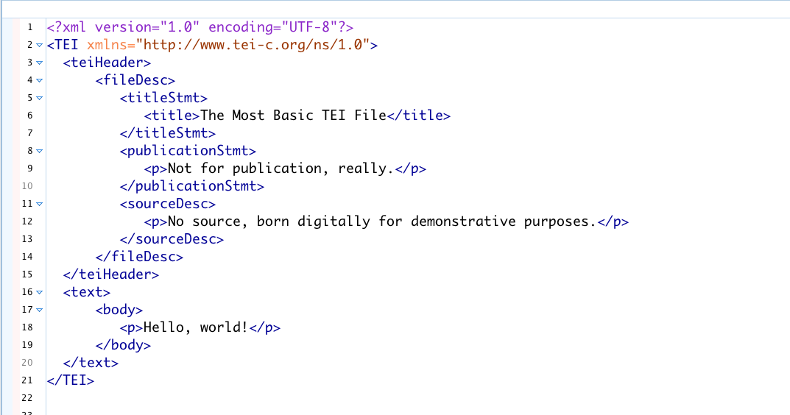
Basic TEI File

Slide 31
TEI
Note that the TEI is huge (569 elements)
No one uses the entirety of the TEI tagset
Individual projects customize the TEI for their own needs, usually using a small subset of the overall tagset (more on this in Workshop #2 in October!)
E.g. Drama projects will use the drama tagset (<sp> for speech, <speaker> for speaker, et cetera) and discard the linguistic/dictionary tagset (<entry> for dictionary entries, <m> for morpheme, etc).

Slide 32
Sample TEI Projects

Slide 33
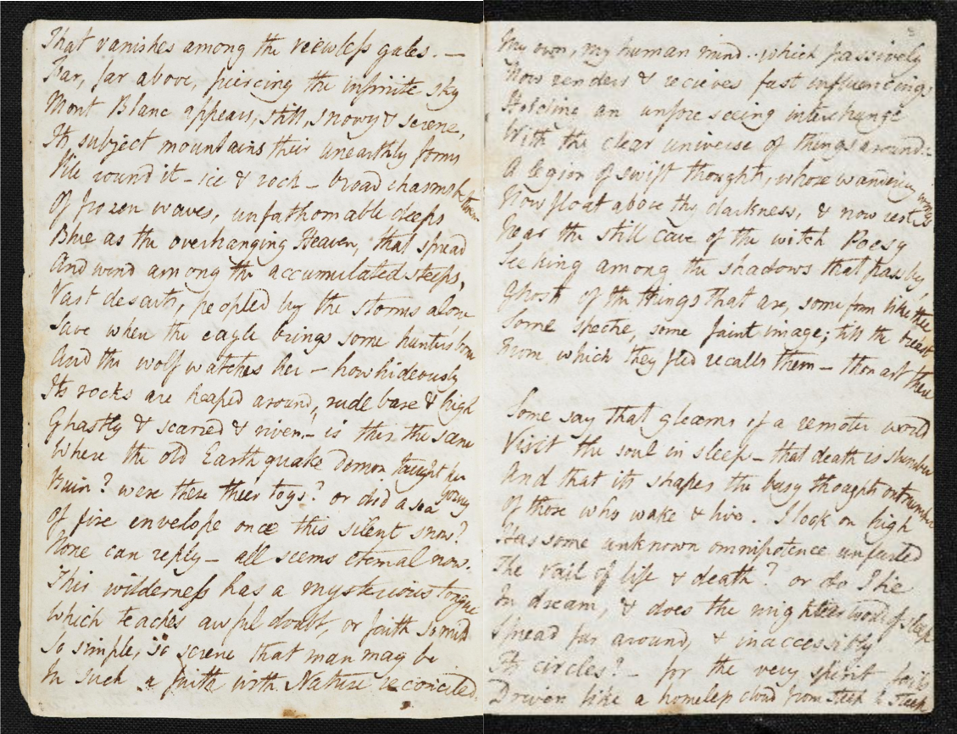
The Shelley-Godwin Archive

Slide 34
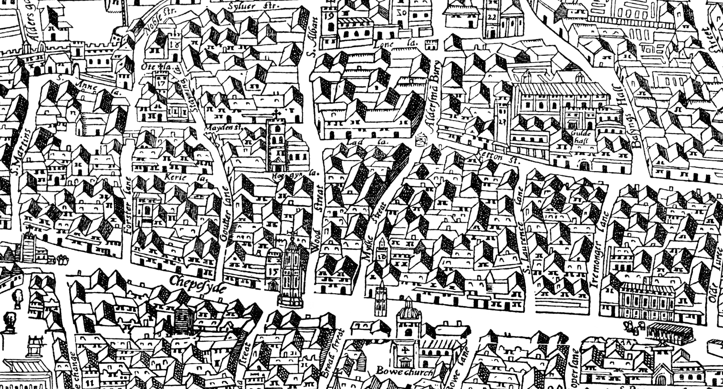
The Map of Early Modern London

Slide 35
Le Mariage
https://mariage.uvic.ca/iai_les_crochets.html

Slide 36
He Do the Police in Different Voices

Slide 37
Resources
The TEI’s website: https://tei-c.org
TEI by Example: http://teibyexample.org/
Lou Burnard, What is the Text Encoding Initiative?: https://books.openedition.org/oep/679?lang=en
Teach Yourself TEI: http://www.tei-c.org/support/learn/teach-yourself-tei/
DHSI @ Uvic: http://www.dhsi.org/courses.php

Slide 38
Next Workshop
October 20, 2018
Focus will be on tools for working with and deploying TEI
Please bring a text (doesn’t have to be a primary source text—it can be a journal article or an essay!)

Slide 39
Thanks!
UBC Libraries, esp. Allan Cho for the invitation!
Martin Holmes and Janelle Jenstad for materials

